Slide 1
ZombieFinder Detecting zombie processes on Windows and the Things keeping them [un]dead
Aaron Margosis’ SysNocturnals Tools
https://github.com/AaronMargosis/Aaron-Margosis-SysNocturnals-Tools

Slide 2
TODO
LESS TEXT. REPLACE TEXT WITH IMAGES. SCRIPT IN THE NOTES.
POWERPOINT IS A PRESENTATION AID, NOT A PRESENTATION REPLACEMENT.

Slide 3
SPOILER

Slide 4
What is a “zombie?”
Specific type of resource leak:
Process or thread object in kernel memory long after the process has exited
Can be serious performance killer
Reliably detectable… but invisible to standard tools

Slide 5
What causes zombies?
A long-running process …
gets a HANDLE to another process or thread
never closes the HANDLE… and the other process exits
or
Kernel code references a process/thread and forgets
→ Hard/impossible to identify the guilty party

Slide 6

Handles (oversimplified)
User mode
Kernel mode
SampleApp process object
Handle table
Processes…
0004
0008
000C
0010
0014
SampleApp.exe
h = OpenExistingFile(C:\file.txt)
data = ReadFile(h)
CloseFile(h)
I/O Manager
File obj.

Slide 7
Handle leaks (oversimplified)
User mode
Kernel mode
SampleApp process object
Handle table
Processes…
0004
0008
000C
0010
0014
DifferentApp.exe
SampleApp.exe
h = OpenExistingFile(C:\file.txt)
data = ReadFile(h)
h = OpenExistingFile(C:\file2.txt)
I/O Manager
File obj.
File obj.

Slide 8
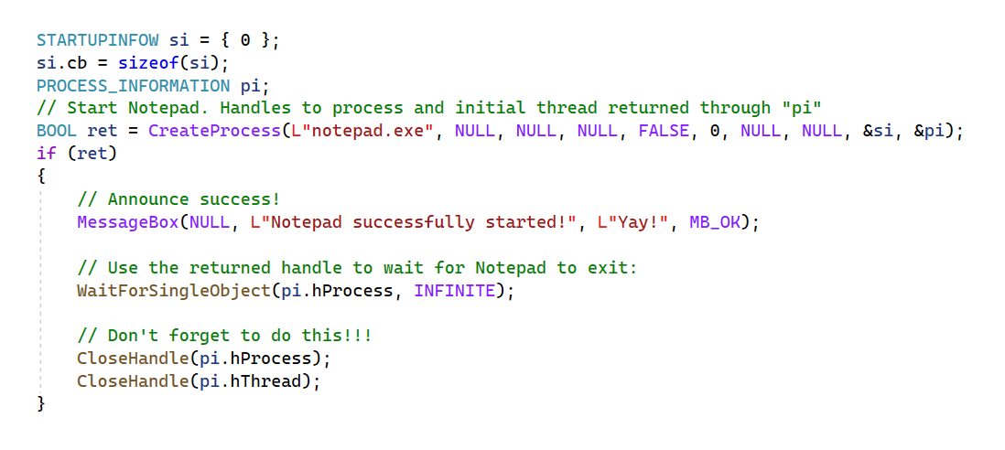

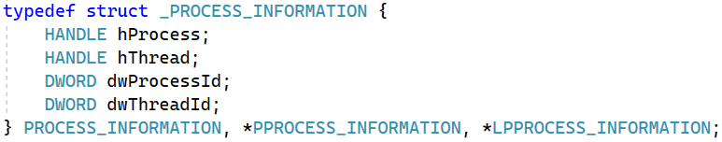
One frequent zombie cause:
Devs forget to do both of these!

Slide 9
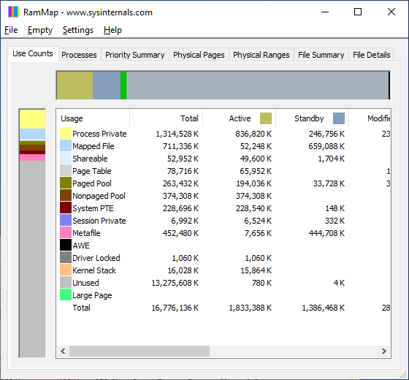
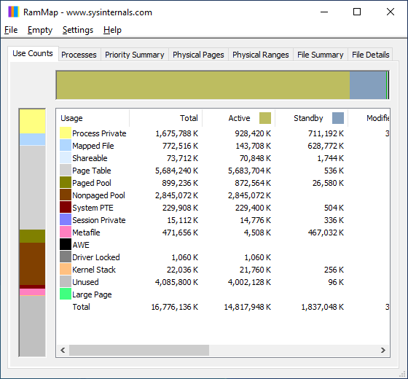
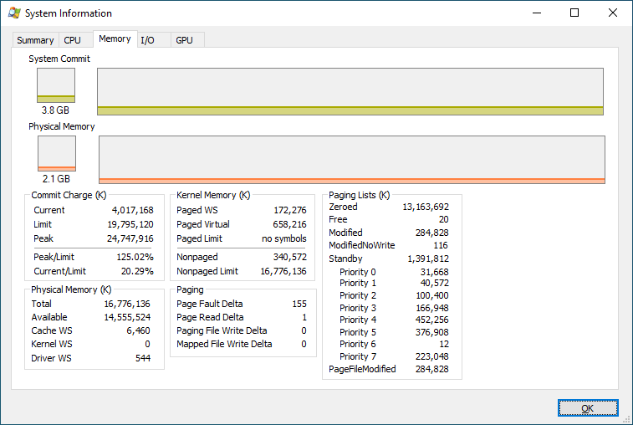
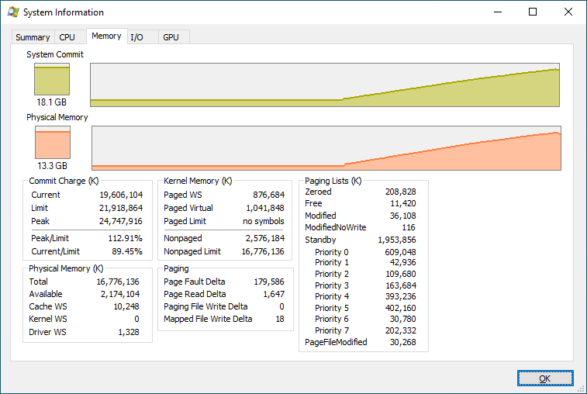
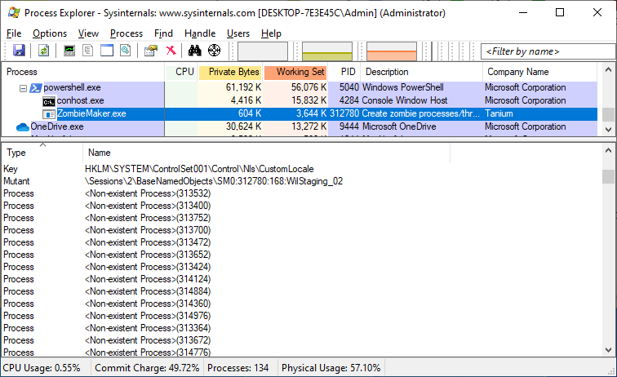
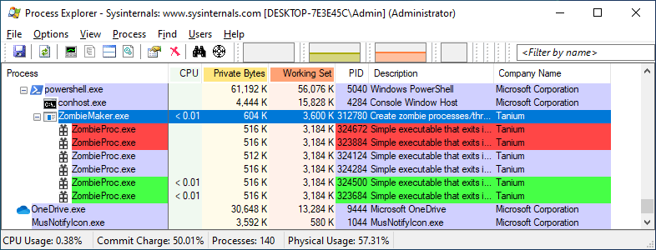
Impact of zombies

Slide 10
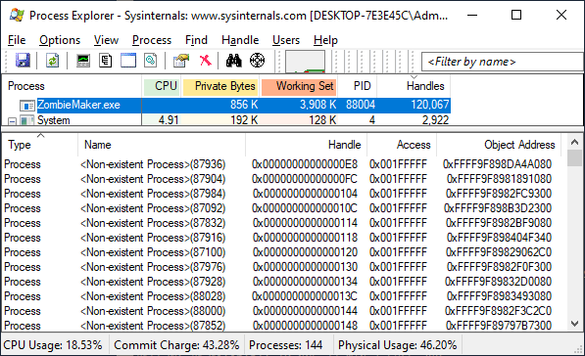
Why are zombies invisible to standard tools?
Limited Win32 API support

Slide 11
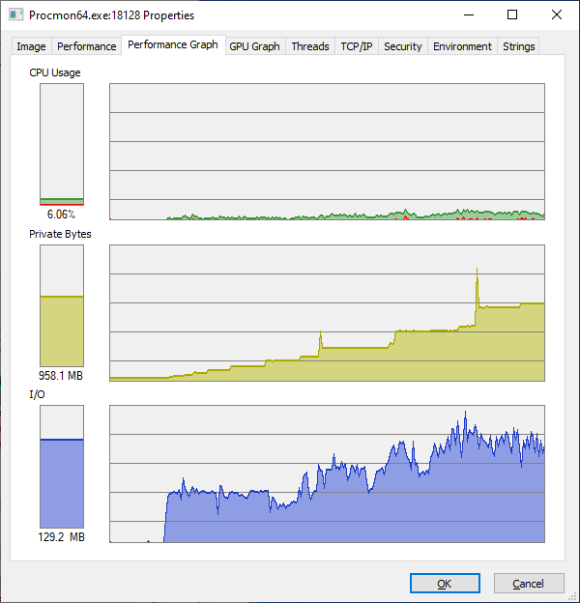
Zombie leaks more detectable than others?
Define resource “leak” →
Process loses track of it
Can’t use it
Can’t release it
Can you tell?
Memory, files, keys, synch objects, … ?
Processes/threads that are long gone … (!!!)

Slide 12
Finding zombies and their owners… Cleverness in Bruce Dawson’s FindZombieHandles
Enumerate all processes (NtGetNextProcess) and identify those that have exited
Enumerate any remaining thread objects in those zombie processes (NtGetNextThread)
Get all the handles in all running process’ handle tables (NtQuerySystemInformation(SystemExtendedHandleInformation, …)
Match up those handles to those zombie processes/threads
For developers
For developers

Slide 13
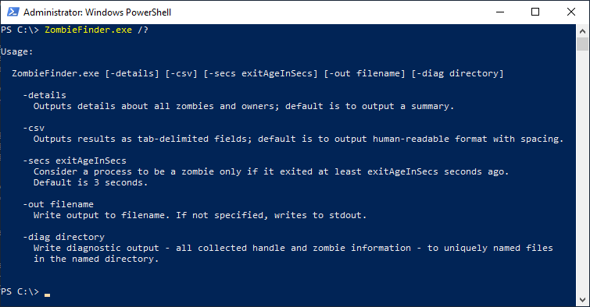
Introducing ZombieFinder.exe
(*) and ZombieFinder32.exe for x86

Slide 14
DEMO

Slide 15
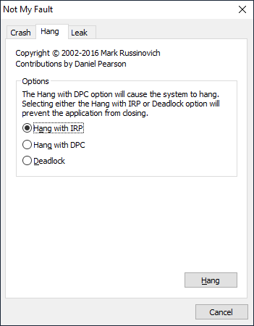
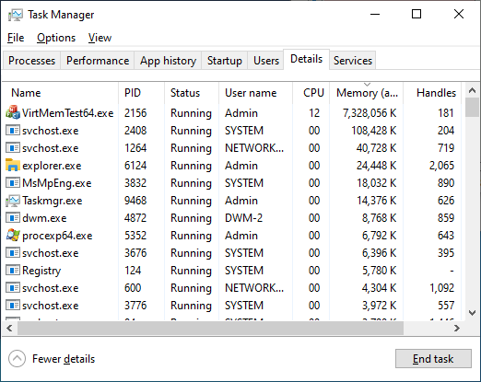
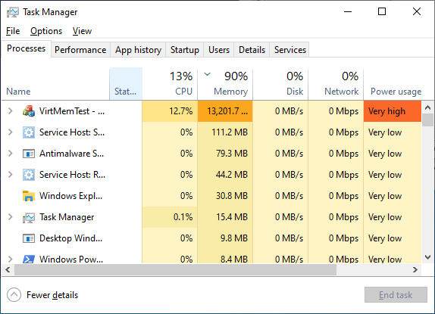
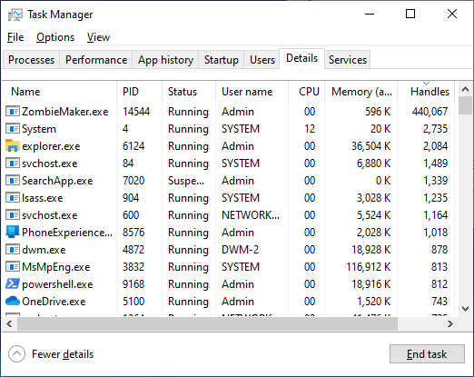
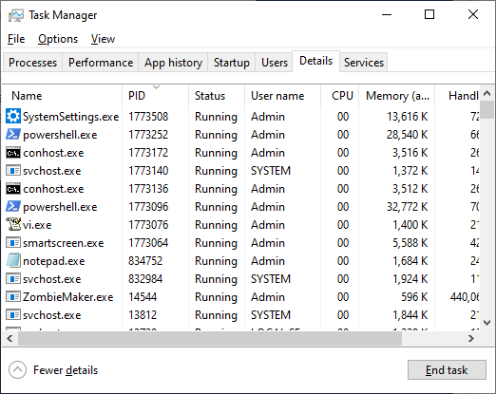
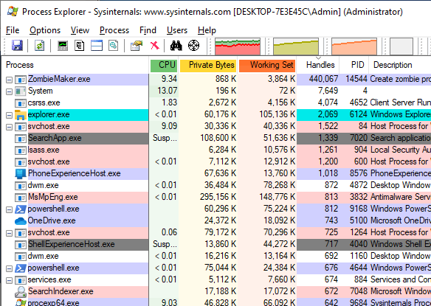
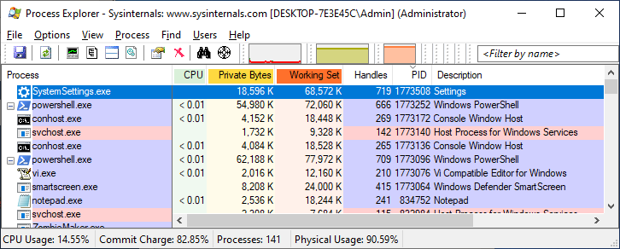
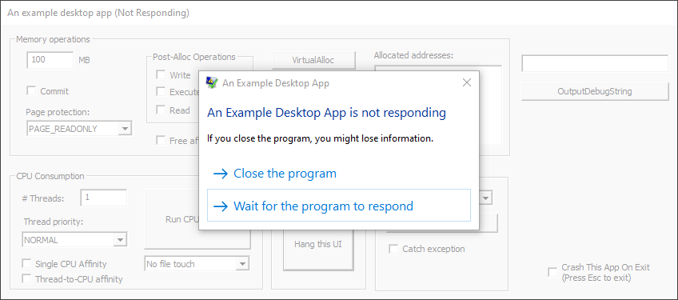
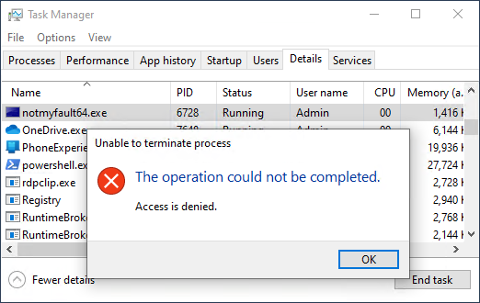
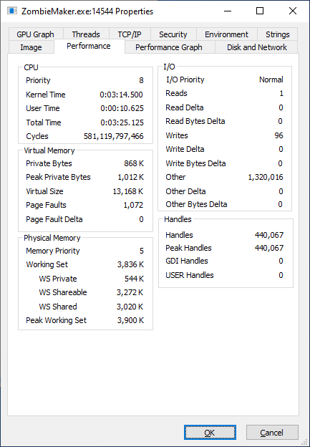
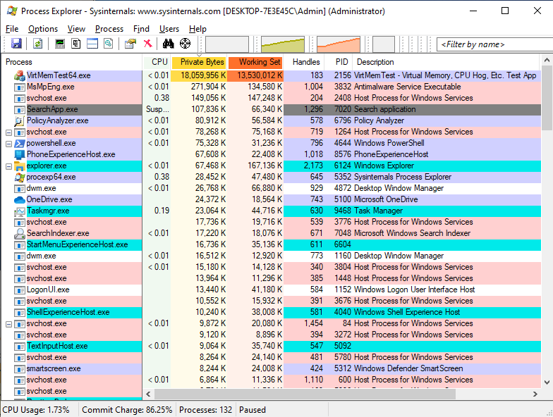
Zombie symptoms and non-symptoms

Slide 16
FIN

Slide 17
References
Zombie Processes – Pavel Yosifovich
Zombie Processes are Eating your Memory – Bruce Dawson
FindZombieHandles source (github.com)
Unkillable Processes – Mark Russinovich (2005)

Slide 18
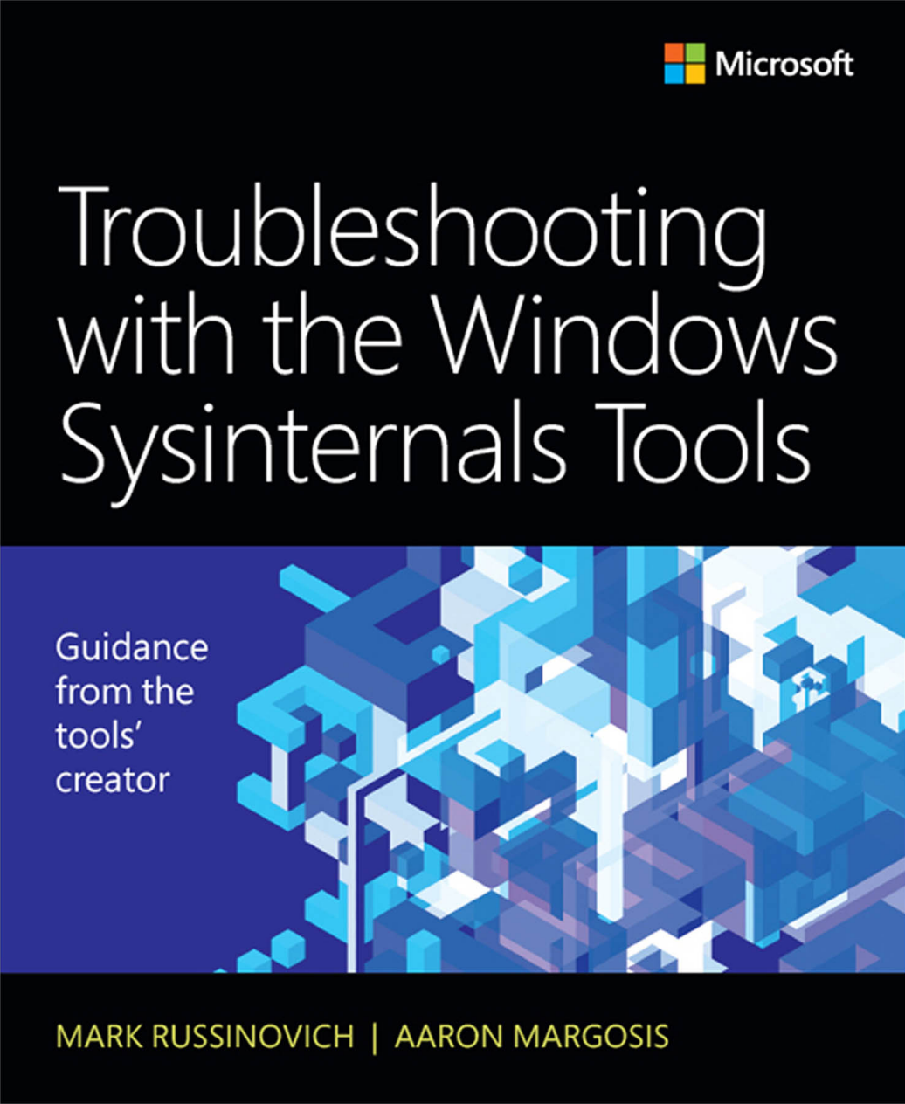

Slide 19
That Excel macro I used…
Sub FormatCSV()
Selection.AutoFilter
With ActiveWindow
.SplitColumn = 0
.SplitRow = 1
End With
ActiveWindow.FreezePanes = True
'ActiveWindow.Zoom = 80 ‘ Uncomment this to zoom everything out a little
Cells.Select
Selection.Font.Size = 9.5
Selection.VerticalAlignment = xlTop
Cells.EntireColumn.AutoFit
Range("A2").Select
Dim ix As Long
Const maxWidth As Long = 45
ix = 1
' Set max column widths for all but the last column
While (Len(Cells(1, ix + 1)) > 0)
If Cells(1, ix).ColumnWidth > maxWidth Then Cells(1, ix).ColumnWidth = maxWidth
ix = ix + 1
Wend
End Sub

